Slide 1

DEPARTMENT OF COMPUTER SCIENCE AND ENGINEERING (AI&ML)
Vulnerability Evaluation Method for E-Commerce Transaction Systems With Unobservable Transitions
Presented by:
D.SUSMITHA (216Y5A6601)
U.SWATHI (206Y1A6649)
N.BHARANI (206Y1A6636)
B.BHAVANI (206Y1A6606)
Under the Guidance of Asst Prof.B.Chiranjeevi

Slide 2
CONTENTS
ABSTRACT
INTRODUCTION
PROBLEM STATEMENT
EXISTING SYSTEM
PROPOSED SYSTEM
SOFTWARE REQUIREMENTS
HARDWARE REQUIREMENTS
ARCHITECTURE
IMPLEMENTATION RESULTS AND TEST CASES
ADVANTAGES
DISADVANTAGES
CONCLUSION

Slide 3
ABSTRACT
E-commerce systems are still undergoing development, but they're often vulnerable to hidden actions and attacks, making security a big concern.
VET-net is a helpful model for understanding hidden actions and transactions in e-commerce systems.
We use VET-net to detect and assess e-commerce system vulnerabilities, introducing the concept of vulnerable transitions, including hidden actions and then we use an improved slice method to locate the vulnerable transitions.
We propose a vulnerability evaluation method called HMM-RG, using hidden Markov models to assess vulnerable transitions in e-commerce systems, demonstrating its efficacy with a real-world case.

Slide 4
INTRODUCTION
With the development of e-commerce, an increasing number of people are paying attention to the study of economic systems. Due to the imperfect nature of the e-commerce system itself, there are many problems in managing e-commerce systems.
For a safe system, there are methods that can be used to diagnose insecurity for users, such as those an e-commerce system is not completely secure.
VET-nets help identify normal and malicious actions in e-commerce systems, focusing on unobservable transitions that can lead to security vulnerabilities. Existing methods often overlook these hidden actions, making them less effective in preventing attacks.
The paper's goal is to evaluate vulnerabilities caused by these unobservable actions to enhance e-commerce security, emphasizing prevention rather than just post-attack analysis.

Slide 5
PROBLEM STATEMENT
The rapid growth of e-commerce has led to complex transaction systems with both observable and unobservable actions. While traditional methods can identify vulnerabilities in observable transitions, they struggle with unobservable ones, creating blind spots for potential attacks.
It aims to develop a comprehensive vulnerability assessment approach specifically tailored to e-commerce systems, considering unobservable transitions to ensure robust security measures.

Slide 6
EXISTING SYSTEM
There is no proper VULNERABILITY ANALYSIS AND EVALUATION method due to lack of technology.
There is no technique called hidden Markov model (HMM) to find vulnerability on datasets.

Slide 7
PROPOSED SYSTEM
We propose the concept of vulnerable transitions, which includes not only vulnerable actions but also unobservable transitions. We present a new method to locate the vulnerable transitions of a VET-net.
We use hidden Markov models (HMMs) to approximate the state reachability graph of a VET-net. Based on this, we give a vulnerable state evaluation method for a VET-net.

Slide 8
SOFTWARE REQUIREMENTS
Operating System - Windows XP
Coding Language - Java/J2EE(JSP, Servlet)
Front End - J2EE
Back End - MySQL
HARDWARE REQUIREMENTS
Processor - Pentium –IV
RAM - 4 GB (min)
Hard Disk - 20 GB
Key Board - Standard Windows Keyboard
Mouse - Two or Three Button Mouse
Monitor - SVGA

Slide 9
ARCHITECTURE
Admin
Login,
View All Users and Authorize,
View All Datasets,
View All Datasets By Finite State Markov Chain,
View Evaluation Results,
View Payment Type Results,
View Delivery Status Results.
Accepting all Information
Web Server
Datasets Results Storage
Accessing Data
Process all user queries
WEB Database
Store and retrievals

Slide 10
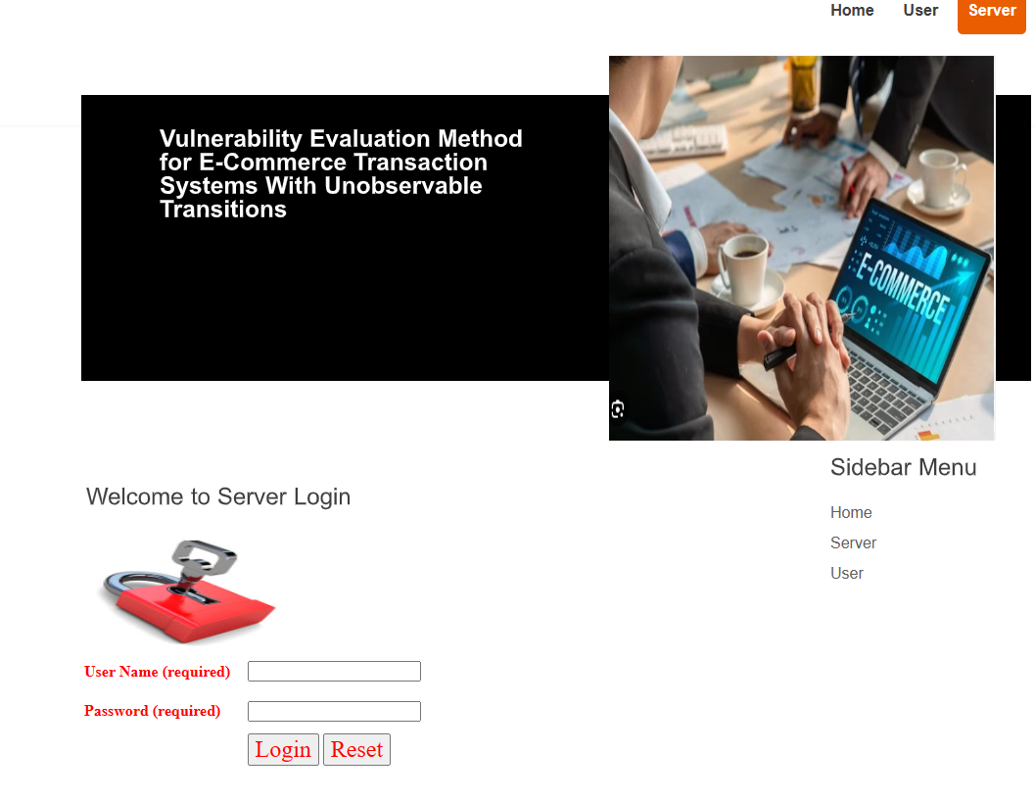
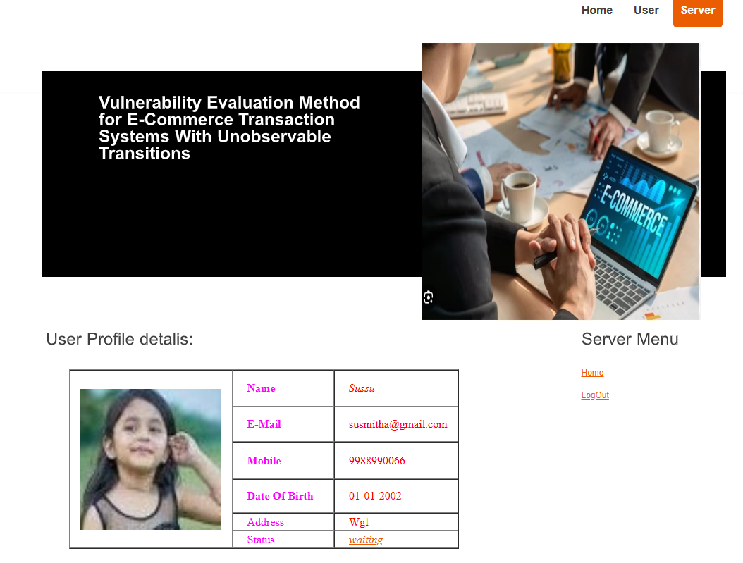
IMPLEMENTATION RESULTS AND TEST CASES

Slide 11
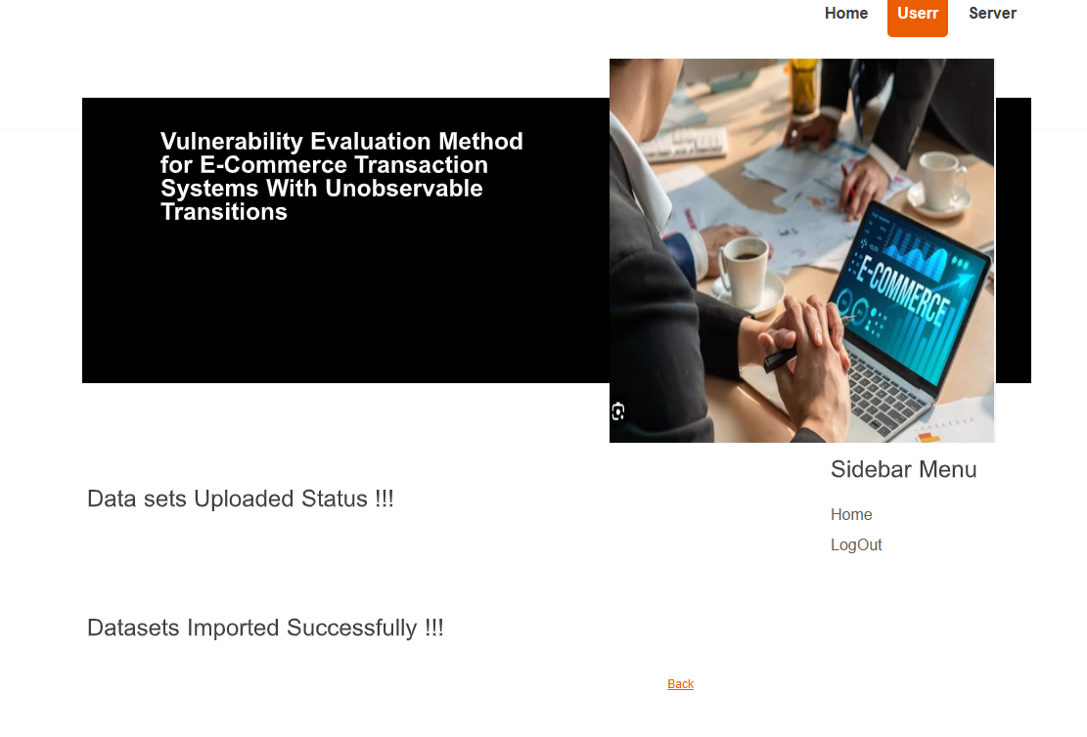
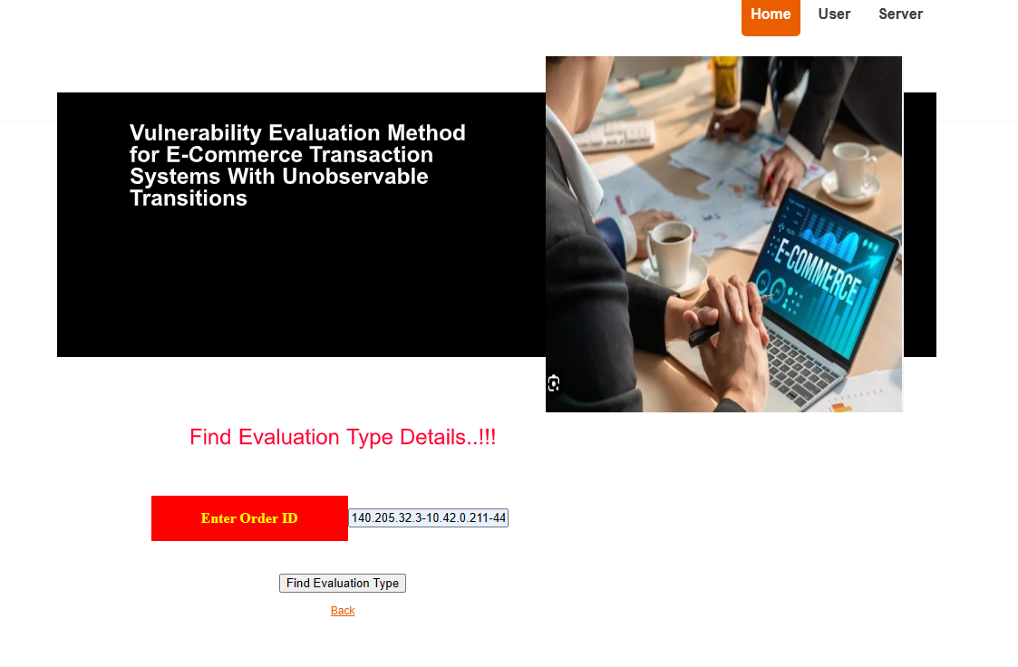
IMPLEMENTATION RESULTS AND TEST CASES

Slide 12
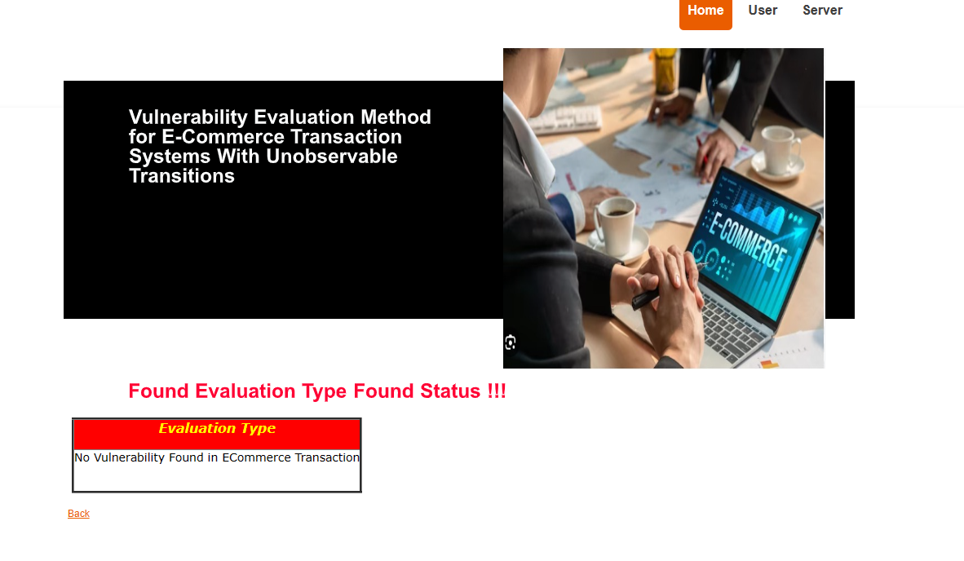
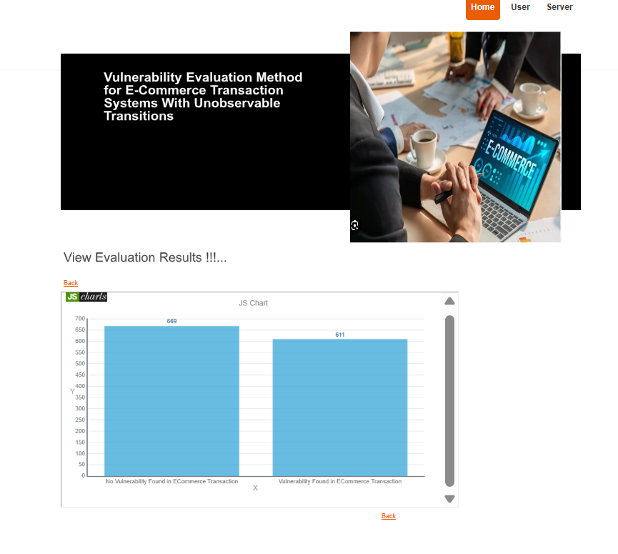
IMPLEMENTATION RESULTS AND TEST CASES

Slide 13
ADVANTAGES
Use the PIPE tool to obtain the reachability graph.
Compute the occurrence probability of vulnerable transitions based on the hidden Markov model (HMM) along with the reachability graph (HMM-RG).
Use the HMM-RG state occurrence probability to obtain the evaluation computation of vulnerable transitions.

Slide 14
CONCLUSION
This project identifies e-commerce system vulnerabilities using VET-nets to spot hidden transitions that could lead to security risks. It uses Hidden Markov Models to evaluate these weak points in online transactions, providing insights into potential security breaches.
The method has limitations with systems requiring detailed data analysis. Future work aims to address these gaps, underscoring the need to enhance e-commerce security and reliability.

Slide 15


